Slide 1
2021S AML 3406
AI AND ML CAPSTONE PROJECT
Presented by:
Group 1
Members:
Ajay Dahiya
Akshita Khatri
Angelica Serrano
Jonatas Aguiar
Faculty Supervisor:
Vahid Hadavi, PhD, P.Eng

Slide 2
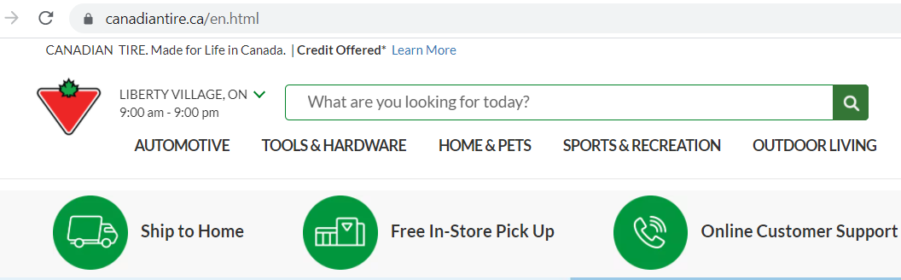

1
PROBLEM STATEMENT
I don’t know its name
Canadian Tire is a Canadian retail company that sells various products – from automotive to household supplies, tools, hardware and a lot more.
Their website has conventional search methods that need to be modernized for enhanced customer experience.
Often, consumers forget, or are not familiar about the name of the product they are looking for.

Slide 3
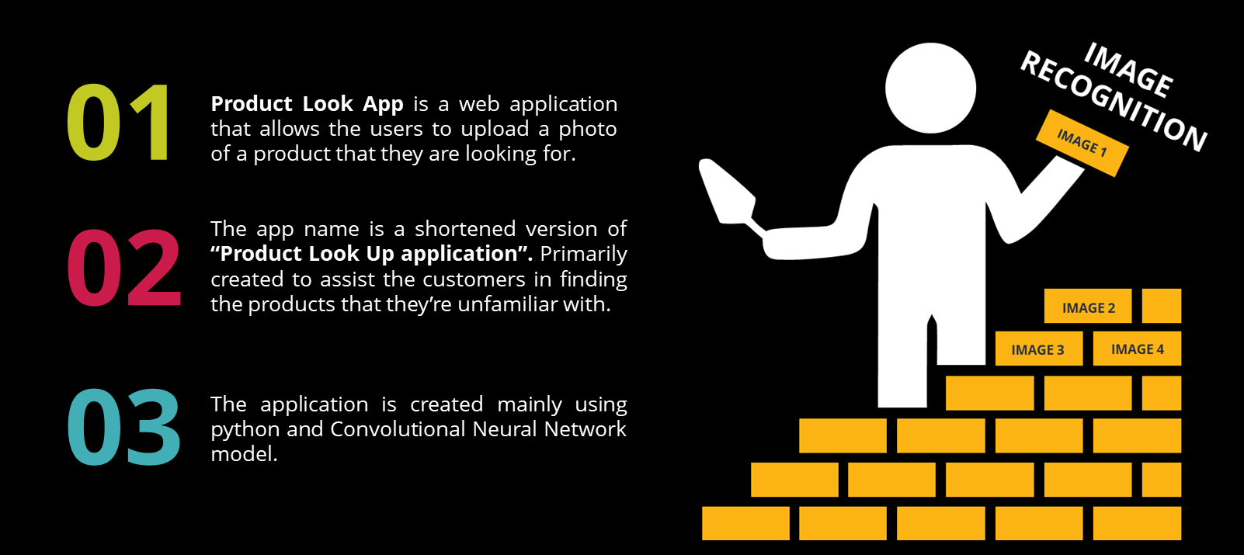
2
SOLUTION: PRODUCT LOOK APP

Slide 4

3
DATA COLLECTION
CANADIAN TIRE
BEAUTIFUL SOUP
Images that were used to train the CNN model was scraped from Canadian Tire website.
Beautiful Soup was used in scraping product images and URLs from Canadian Tire website.
SELENIUM
PYTHON
Selenium webdriver module functions as navigator to a page given by the URL.
Python codes for each five sections were created separately to extract samples.

Slide 5
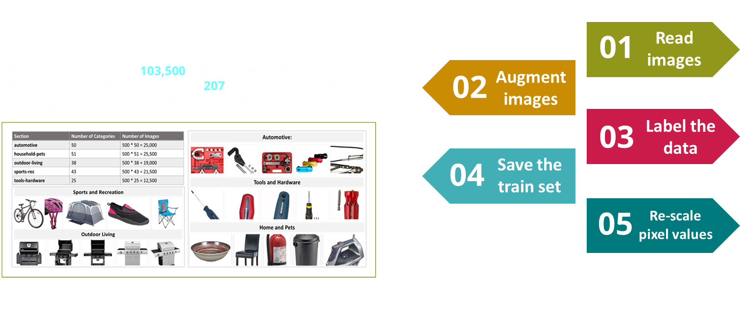
4
DATA PRE-PROCESSING
TRAIN DATASET
CATEGORIES
AUTOMOTIVE
TOOLS & HARDWARE
HOME & PETS
SPORTS & RECREATION
OUTDOOR LIVING

Slide 6
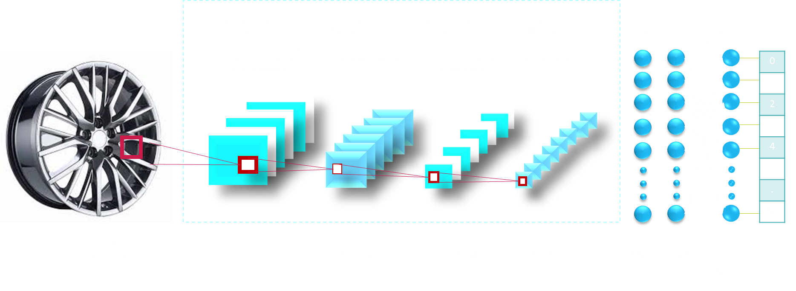
5
CNN MODEL

Slide 7
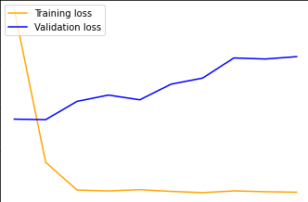
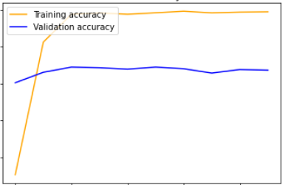
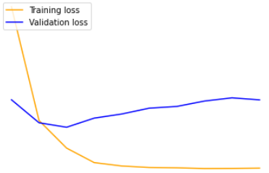
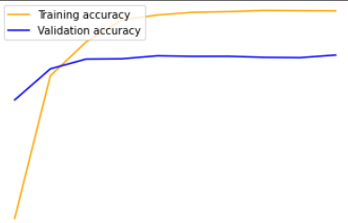
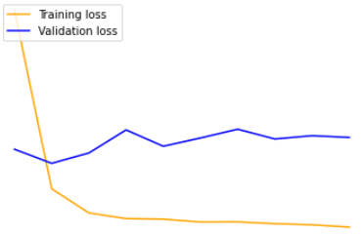
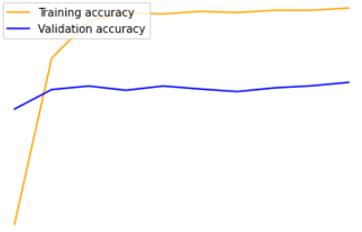
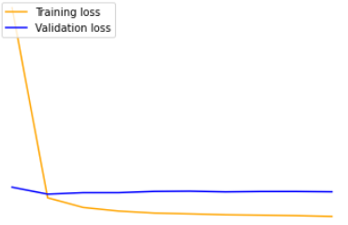
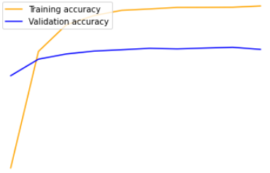
6
CNN MODEL
MODEL 1
MODEL 2
VAL ACCURACY: 88%
VAL ACCURACY: 86%
MODEL 3 VAL ACCURACY: 87%
MODEL 4 VAL ACCURACY: 86%
MODEL 5 VAL ACCURACY: 87%
MODEL 6
MODEL 7
VAL ACCURACY: 88%
VAL ACCURACY: 89%

Slide 8
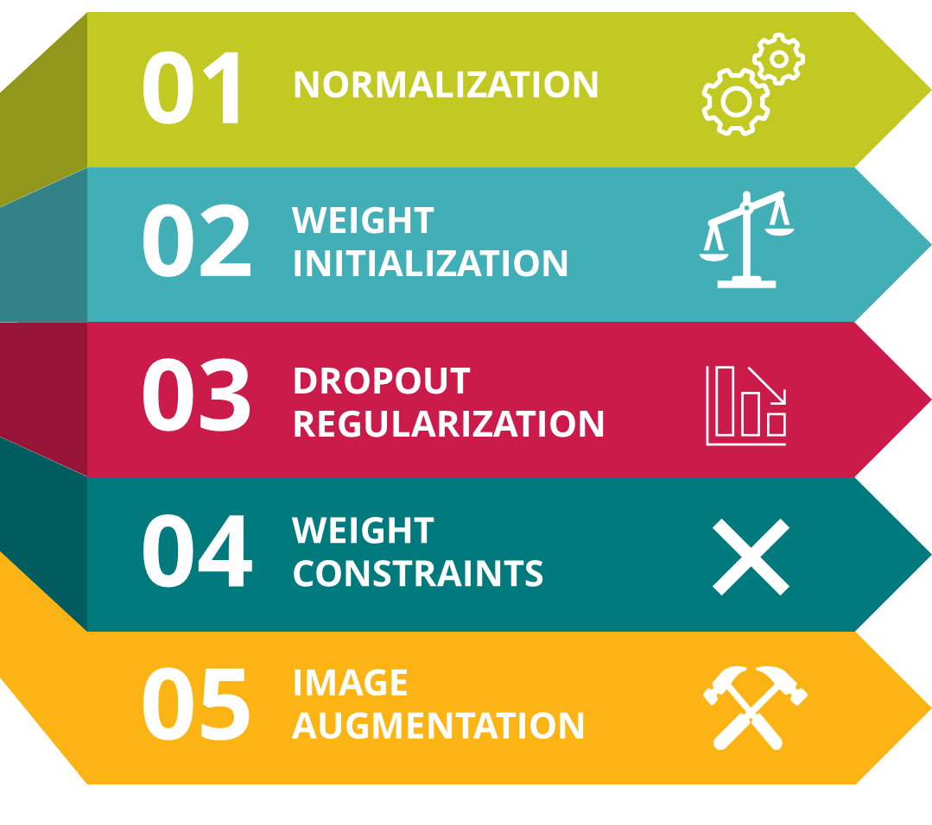
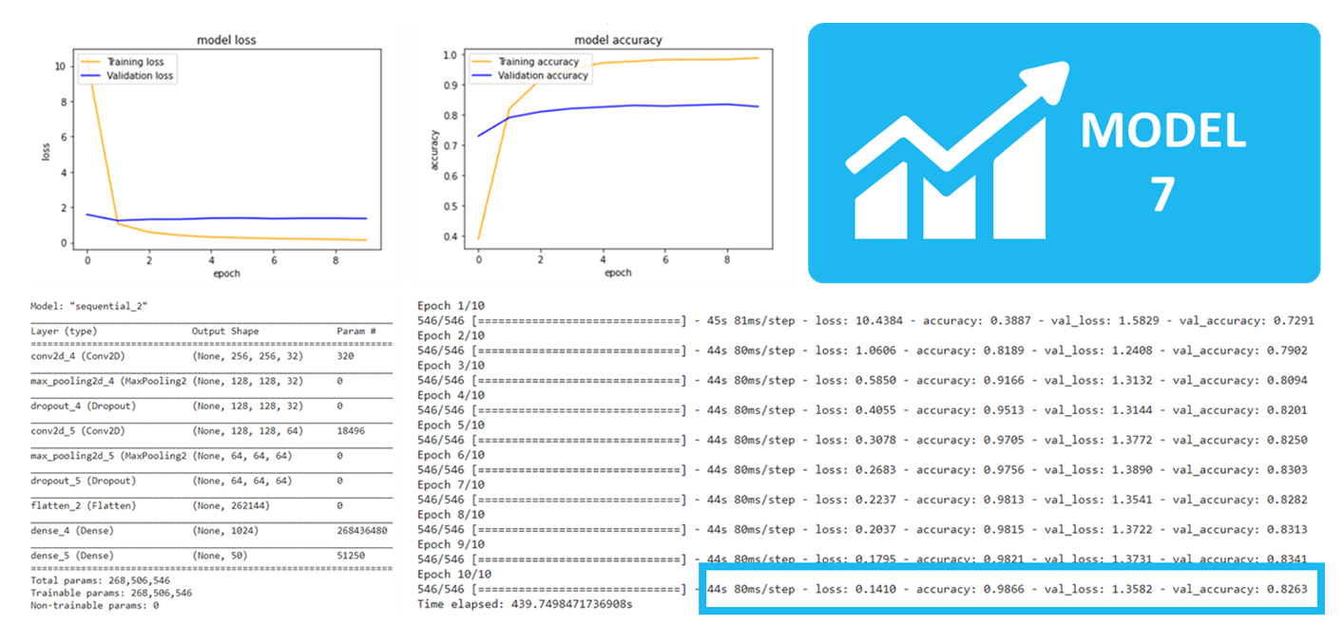
6
CNN MODEL
MODEL 1
MODEL 2
TO REDUCE
OVERFITTING
REGULARIZATION
VAL ACCURACY: 88%
VAL ACCURACY: 86%
MODEL 3 VAL ACCURACY: 87%
MODEL 4 VAL ACCURACY: 86%
MODEL 5 VAL ACCURACY: 87%
MODEL 6
MODEL 7
VAL ACCURACY: 88%
VAL ACCURACY: 89%
VAL LOSS:11, VAL ACC: 89%

Slide 9


7
USER INTERFACE
FRONT-END PROCESS
FRONT-END DESIGN
01
Built Using StreamLit package for python.
02
Responsive UI, work on both mobile and PC web browsers
03
Simple and minimalist design. One-page, easy navigation.
04
Users can choose which category they want to select.

Slide 10
7
USER INTERFACE
FRONT-END PROCESS
BACK-END PROCESS
01
Pre-processed the uploaded photo to grayscale, resize to model dimension, convert to array and re-shape.
02
Parse the prediction output to get the class with highest percentage.
03
Map the output against the data source file.
04
Return the Product Name and Canadian Tire URL.

Slide 11


8
DEPLOYMENT
GitHub was used as code repository.
Streamlit runs the trained model in web framework.
Heroku cloud platform hosts the development server.
Azure cloud platform hosts the production server.
Production server runs in Linux CentOs.
Docker managed the whole application through containerization.

Slide 12
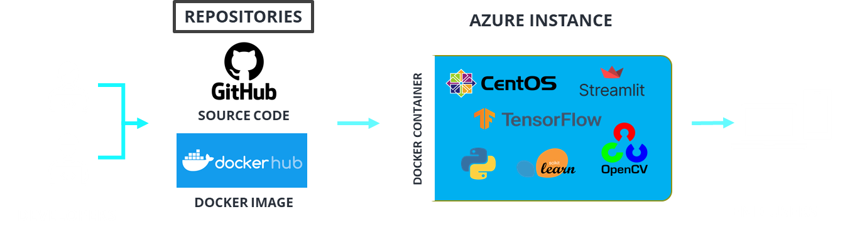
9
DEPLOYMENT
APPLICATION DESIGN - ARCHITECTURE

Slide 13
DEMO
http://productlookapp.eastus.cloudapp.azure.com:8501/

Slide 14
10
SUMMARY
1
The objective of this project is to create an application that will enhance the customer experience of Canadian Tire consumers.
2
The application is named “Product Look App” and uses python and CNN model as primary tools.
3
Overfitting is the major challenge faced during implementation. Followed by RAM and storage size restrictions.
4
UI was created using Streamlit web framework and runs in Azure public cloud through port 8501.
5
The application was Dockerized and image was uploaded to docker hub for public use.

Slide 15

11
PROJECT
JOURNEY

Slide 16
THANK YOU!
Any questions?

